Slide 1
Central Idea
Main question: Is there a bias in wikipedia articles within different languages
We aim to quantify this by building and analysing a network
We will tie text data to network data by analysing text content within communities or high-degree articles
By Magnus (s204072) and Philip (s204147)

Slide 2
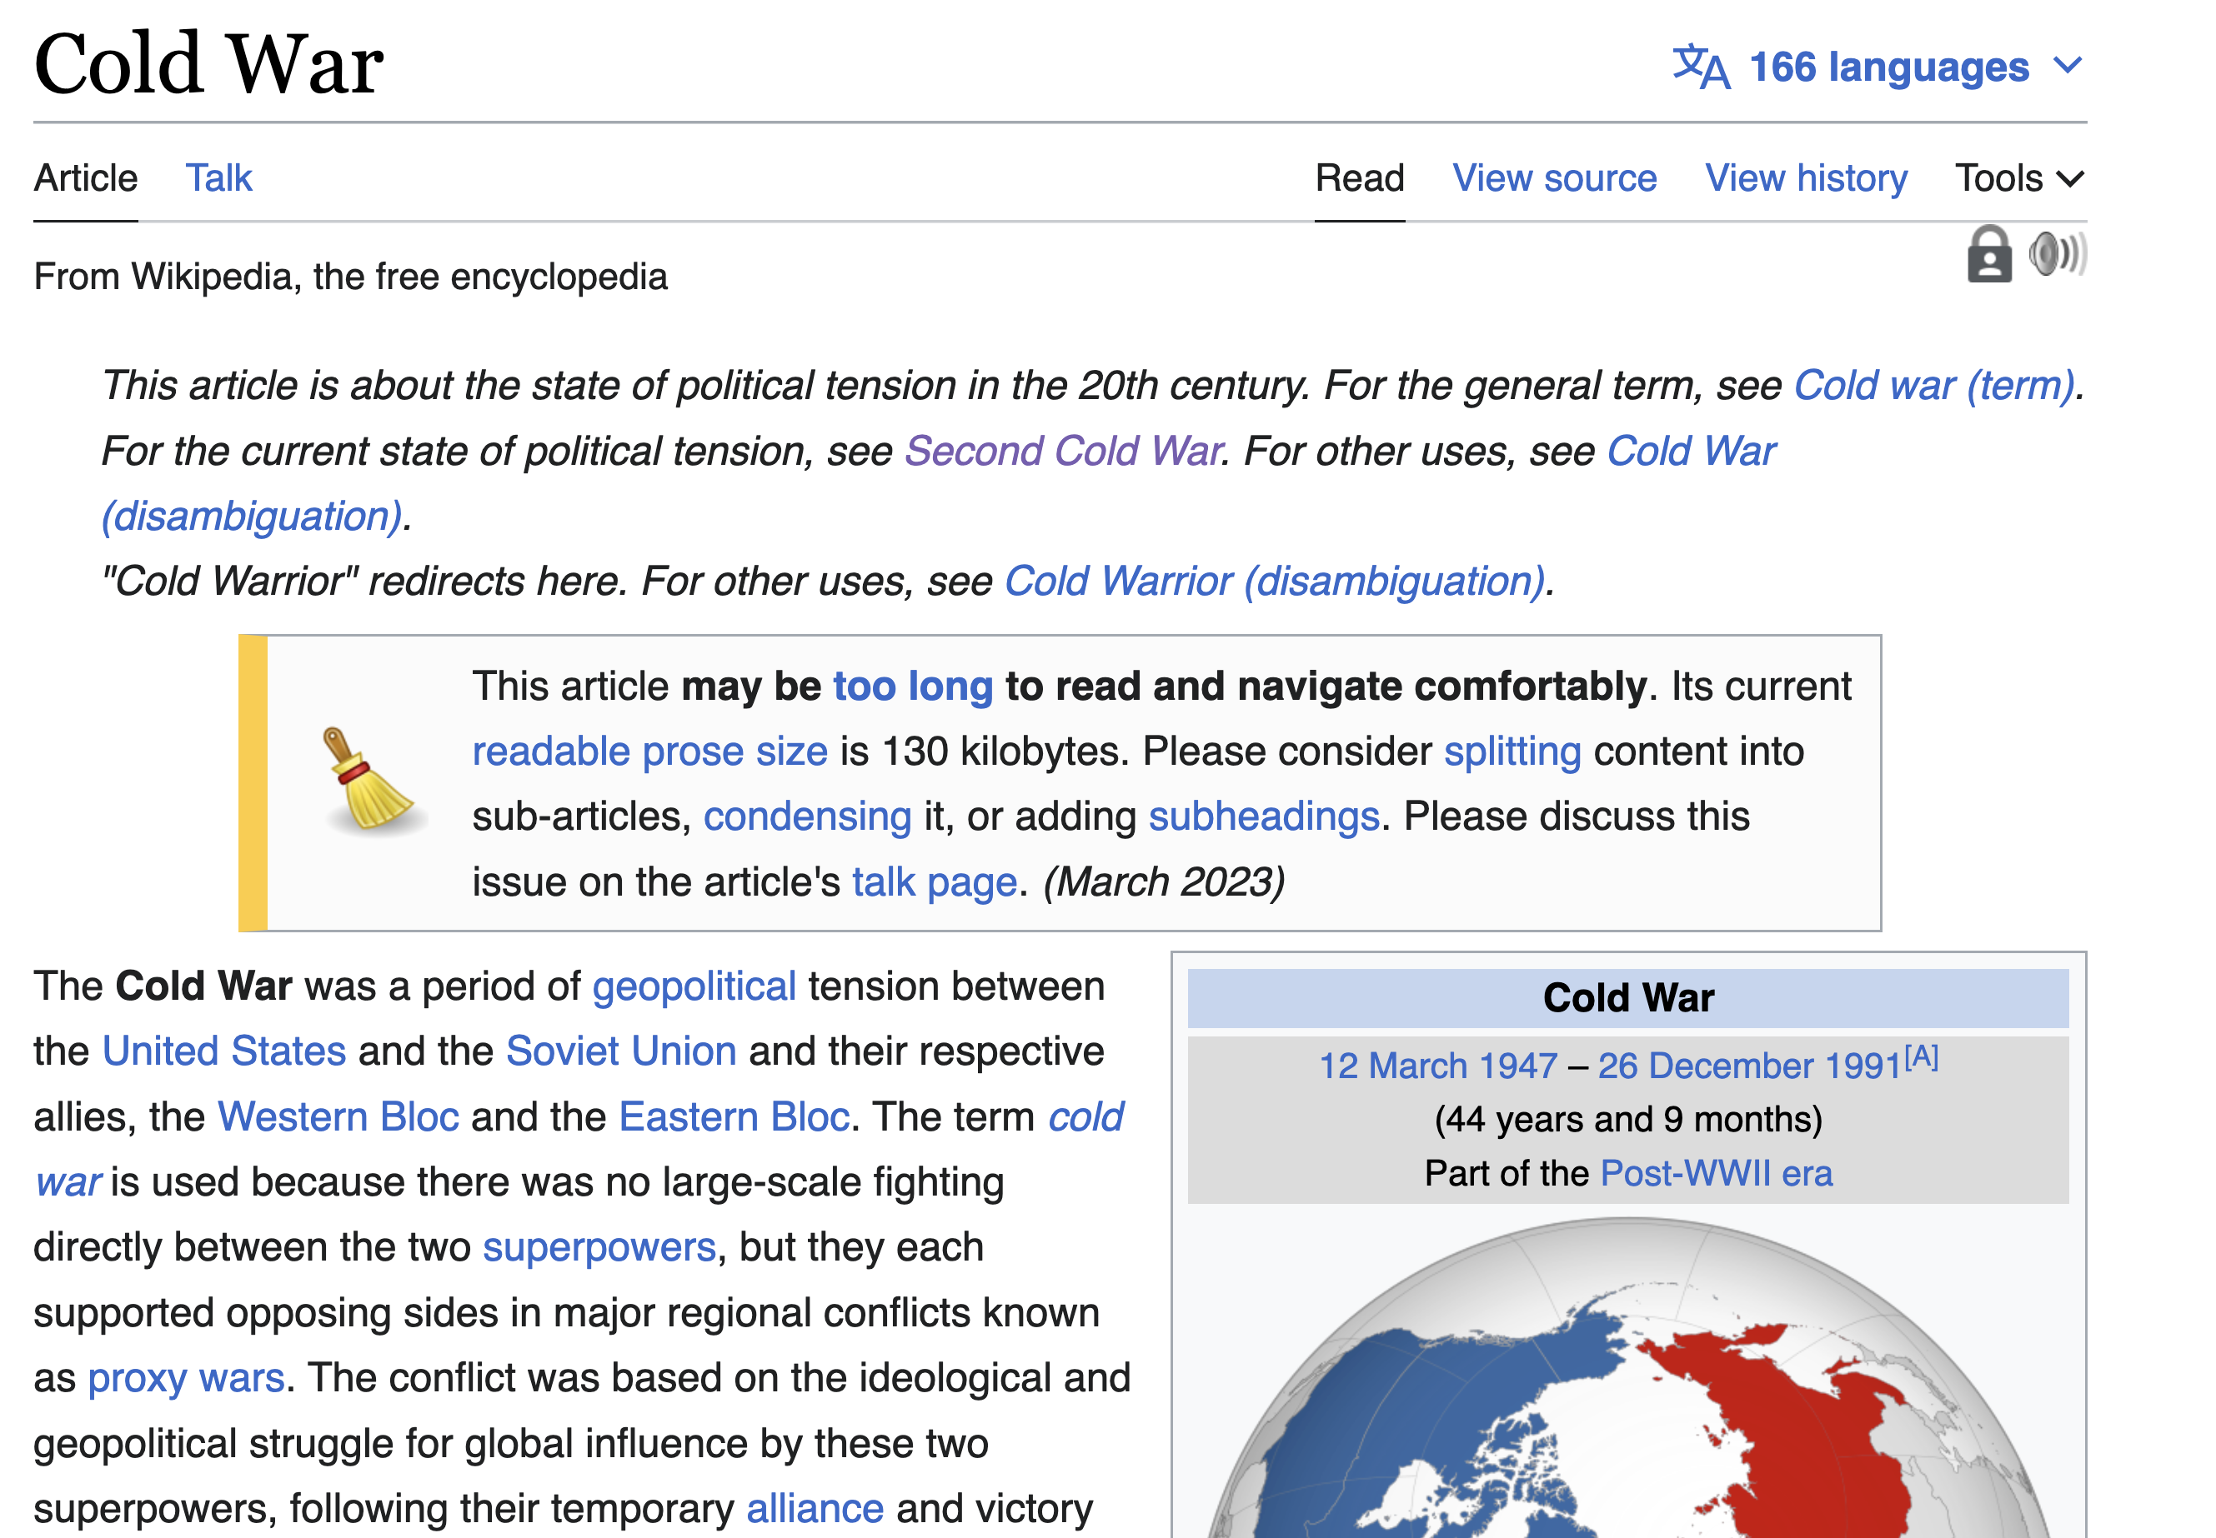
Data
Scrape all references within Cold War page
Build dataset with columns
URL
Title
References
Text
Use text for analysis on communities from Network

Slide 3
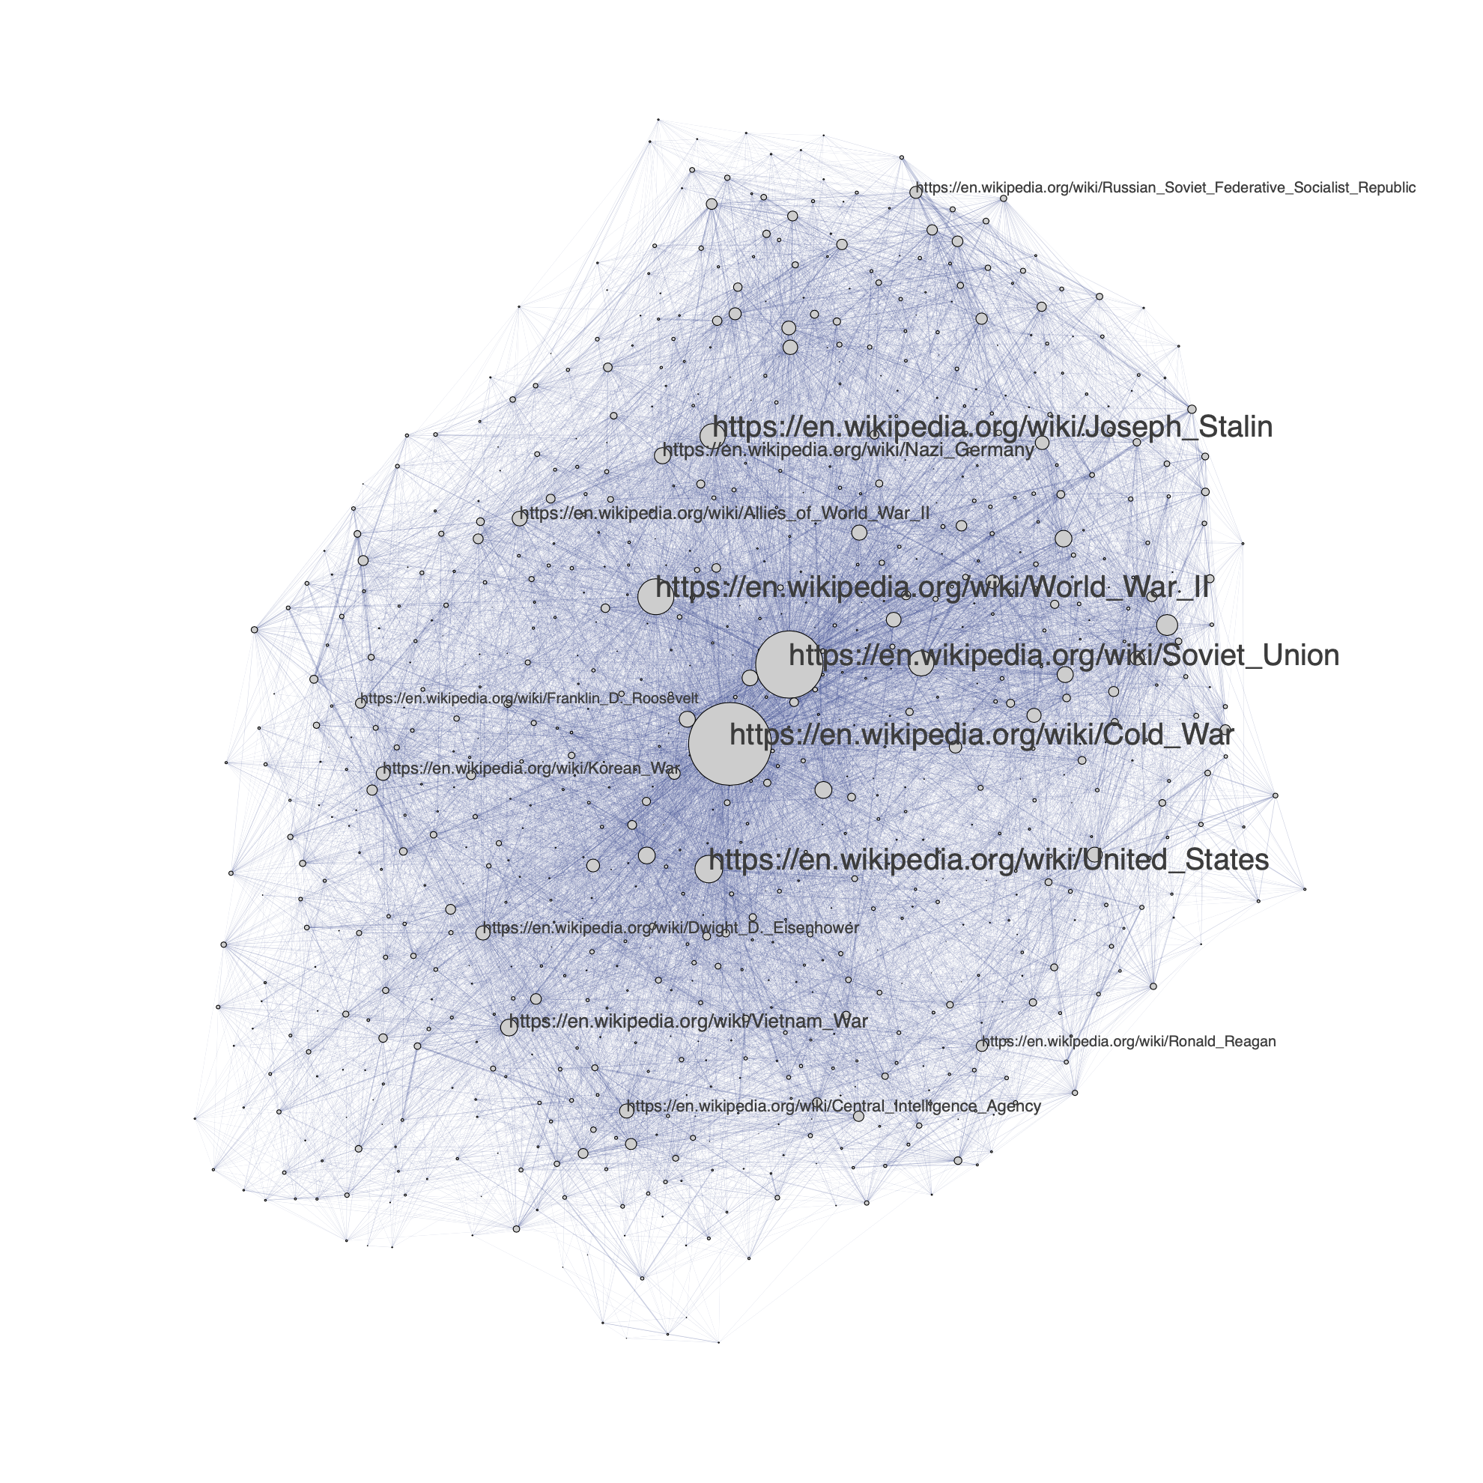
Network
Nodes: One for each URL
857 total
Edges: Weights from total references between two URLs
Undirected
16216 total

